Slide 1

VACCINATION CAMPAIN CLASSIFICATION MODEL

Slide 2

Table Of Content
Business Problem
Patterns and Findings
Modelling
Conclusion

Slide 3

Business Problem
The National Vaccination Advisory committee under the Government's Public Health Office aims to provide vaccination to the whole country and prevent the spread of seasonal flu and H1N1 flu. However, The National Vaccination Advisory faces a challenge on how to administer the vaccine since it isn't compulsory yet it is vital at the same time. Based on the previous vaccination campaigns, the government has had a tough time of deciding which group of citizens are likely to turn up for a vaccination and which are not. Moving forward, National Vaccination Advisory committee wishes to understand which factors contribute to a voluntary intake of the vaccine by the public given a warning of a flu and which factors do not. This information is beneficial to the National Vaccination Advisory committee as it would make it easier for them to identify and direct the necessary resources towards vaccination campaigns, awarness, disease mitigation and procurement procedures.

Slide 4
Patterns and Findings

Slide 5


Data Used
The data used in this project is from the National 2009 H1N1 Flu Survey collected to monitor vaccination rates during the US government vaccination campaigns. The survey asked people whether they had received H1N1 and seasonal flu vaccines. In the survey questions ranging from personal,social, economic to demographic and opinion questions among others were asked in order to have a better understanding of how these characteristics are associated with personal vaccination patterns and how the National Vaccination Advisory committee can provide guidance for future public health efforts.

Slide 6
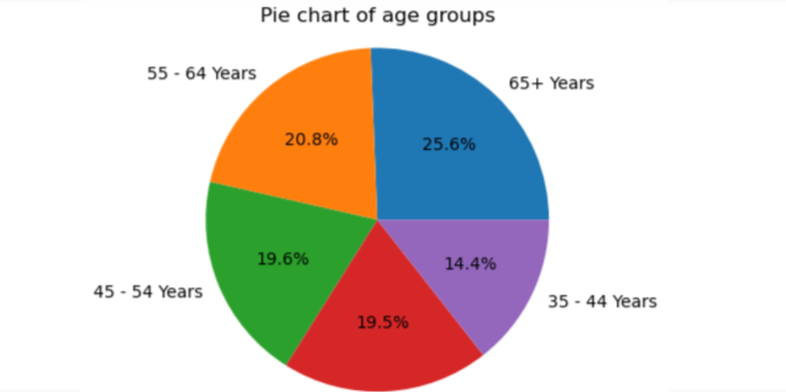

Age Group of the Respondents
From the pie chart above 65+ years accounted for majority of the population in the dataset. The majority are above the age of 45. Ages 35-44 were least participated in the survey

Slide 7
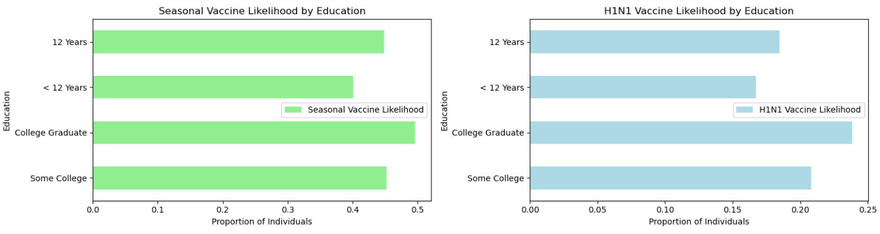
Vaccine Likelihood by Education
In both vaccination cases, people who have graduated college are most likely to take the vaccine while those who have less than 12 years of education are least likely to take the vaccine

Slide 8
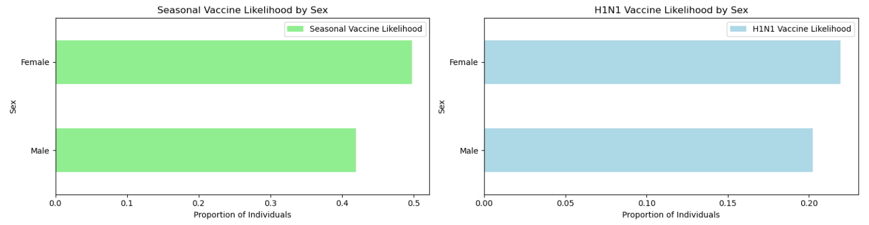
Vaccine Likelihood by Sex
In both vaccinations, females took the vaccines more than males

Slide 9
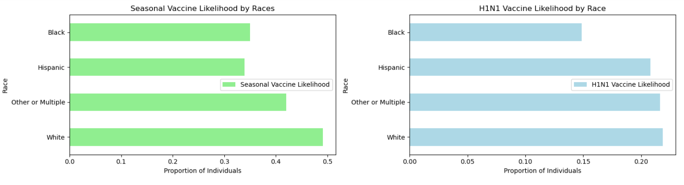
Vaccine Likelihood by Race
White people are most likely to take the seasonal vaccine and black people are the least likely, while in the H1N1 vaccine both white people and other/multiple races are most likely to take the H1N1 vaccine and the hispanics are least likely to take the vaccine

Slide 10
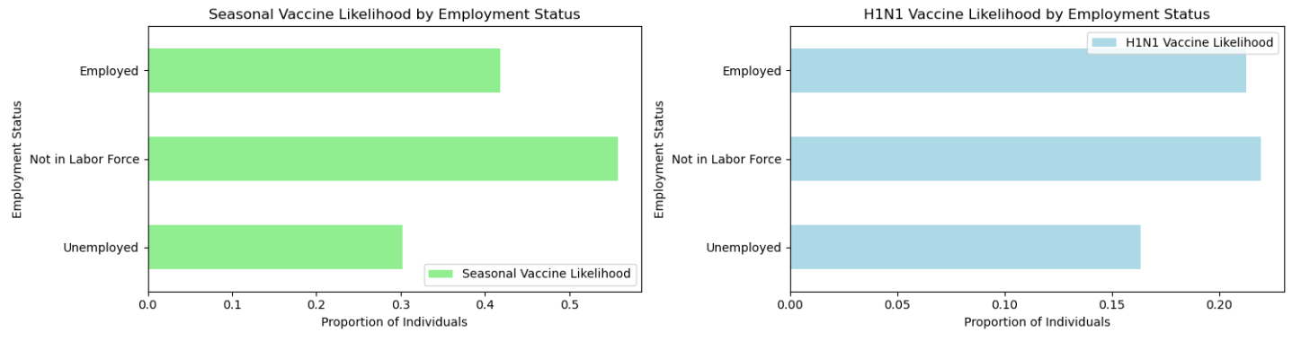
Vaccine Likelihood by Employment Status
According to the barchart, majority of those who take seasonal vaccine are not in the labour force and it's still the same
result for those who took the H1N1

Slide 11
Modelling

Slide 12

Model Selection
Utilized three different machine learning algorithms for modeling: Logistic Regression, Random Forest, and Gradient Boosting Machine (GBM).
Feature Engineering
Conducted preprocessing steps including encoding categorical variables, scaling numerical features, and handling missing values to prepare the data for modeling.

Slide 13
Logistic Regression
Purpose: Used logistic regression to predict the likelihood of individuals getting the seasonal flu vaccine.
Hyperparameter Tuning: Fine-tuned hyperparameters such as regularization strength, penalty, and solver using grid search.
Performance: Achieved a test accuracy of 78.27% and an ROC AUC score of 0.78.
Random Forest
Purpose: Employed a Random Forest classifier to capture complex interactions between features and predict vaccine uptake.
Hyperparameter Tuning: Utilized grid search to optimize hyperparameters including the number of estimators, maximum depth, and minimum samples per leaf.
Performance: Despite hyperparameter tuning, observed overfitting with a training accuracy of 86.29% and a testing accuracy of 78.10%.

Slide 14
Feature Importance Analysis
Identified important features influencing vaccine uptake using the GBM model.
Top features included respondents' concerns about H1N1, knowledge about H1N1, and recommendations from doctors for both H1N1 and seasonal flu vaccines
Model Evaluation
Evaluated models using performance metrics such as accuracy, ROC AUC, F1 score, and recall to assess predictive capability and generalization ability.
Identified GBM as the preferred model due to its balanced performance and reduced overfitting compared to Random Forest.

Slide 15
Conclusion

Slide 16


We experimented with three different types of models: Logistic Regression, Random Forest, and Gradient Boosting Machine (GBM). For each model, we performed hyperparameter tuning using grid search to optimize model performance.
The logistic regression model provided a solid baseline, achieving an accuracy of approximately 78% on the test set. However, it exhibited signs of bias towards predicting individuals who are less likely to get vaccinated, which could lead to higher false negative rates.
Next, we explored ensemble methods like Random Forest and GBM. Random Forest improved upon the logistic regression model, achieving a test accuracy of approximately 78% after hyperparameter tuning. However, it still suffered from some overfitting.

Slide 17
To address overfitting, we employed Gradient Boosting Machine (GBM). The GBM model demonstrated improved generalization performance, with training and testing accuracies converging closer together. It achieved a test accuracy of approximately 79%, along with good precision, recall, and F1 score metrics.
In conclusion, the GBM model is the most suitable model for predicting seasonal flu vaccine uptake and providing valuable insights for healthcare practitioners and policymakers.

Slide 18
Recommendation

Slide 19

Implement educational initiatives to raise awareness about the need of flu vaccination
Encourage healthcare providers to offer flu vaccinations to their patients, especially those with chronic medical conditions
Develop tailored approaches to boost vaccine uptake
Encourage collaboration among public health authorities, healthcare providers, community organizations, and other stakeholders to execute comprehensive immunization strategies

Slide 20

THANK YOU
20
22

